Slide 1
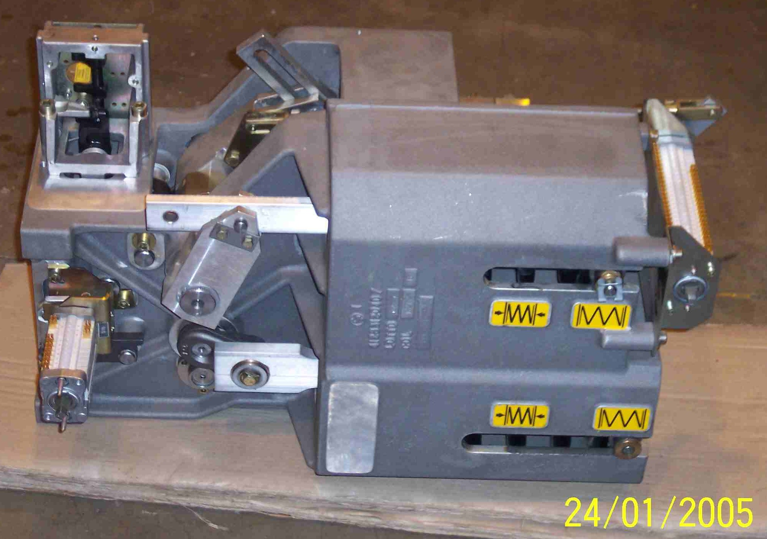
SIEMENS
HVCB SPARES
Drive Mechanism
72.5KA, 31.5KA CB
S4713010001

